Slide 1
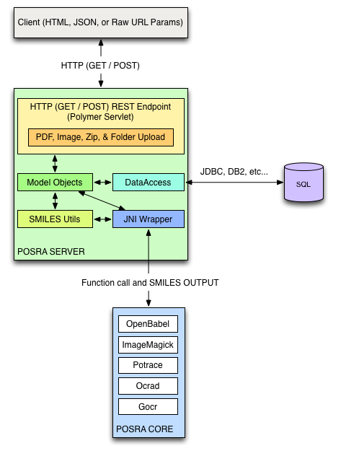
POSRA System Architecture

Slide 2
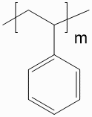
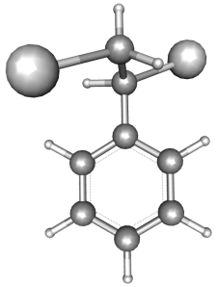


My thoughts on what the POSRA Client may look like
(replacing/extending what UCSC student will deliver by end of spring semester 2014)
e.g.
JSME
JSMol
Polymer Structure Recognition
(POSRA)
*
**
Polymer Query
Draw Polymer Structure
*
CTRL-V to paste image
Upload Polymer Image
image file name on local filesystem
Browse
+ aux. data
Submit Image to Polymer Structure Recognition
EG1: CX1
RU: X1CC(c1ccccc1) X2
EG2: X2C
2D (SMILES)
Structure Recognition Result
3D
X1
X1
X2
X2
**

Slide 3
Polymer Structure Recognition
(POSRA)
Polymer Query
Draw Query Polymer Structure
CLI
CTRL-V to paste image
compose SQL
Upload Polymer Image
image file name on local filesystem
Browse
Submit Polymer Structure Query
aux. data
polystyrene
polymer1
polymer2
EG1: CX1
RU: X1CC(c1ccccc1) X2
EG2: X2C
2D
source: …
year: …
authors: …
Query Result
3D
X1
X2

Slide 4
What language to use for POSRA web UI ?
Java
Vast libraries available, e.g. JChemPaint, JMol
Would restrict deployment to conventional desktops, laptops ?
JavaScript
Compilers are improving
Library support is improving, e.g. JSMol
Graphics is improving (WebGL, JavaScript 3D)
Would open deployment on mobile devices (Android/iOS powered)
A hybrid solution?

